Slide 1

Project title: Library Management system
Team members:
1.Nourhan Ayman Abdel-Moati(teamLeader)
2.Heba Maher Al-shahat
3.Nada Yasser Morsi
4.Nourhan Ayman Al-Sayed

Slide 2

Introduction
This system is designed to the students ,to ease the operation of borrowing the books and returning it , help the admin to mange the huge of books in the library ,knowing amount of book he has and number of borrowed books ,each book has its own unique id, enable admin to update list of books , enable students to have any book to help them in their academic journey
Features
1.Only admin of library can access the information of the system which ensure security of information
2.can student borrow a book or many books for a specific period of time he determine it.(easily to borrow any book , just need student name and his phone)
3.Easily to return book
4.Ability to admin to update the list of books , if new books become available
5.List of books that student may need in his academic journey

Slide 3
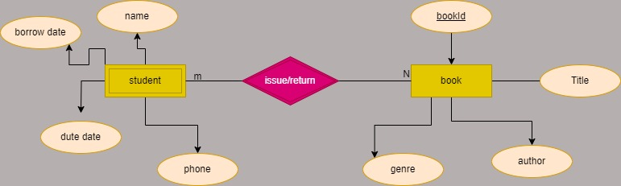
ERD

Slide 4
